Slide 1
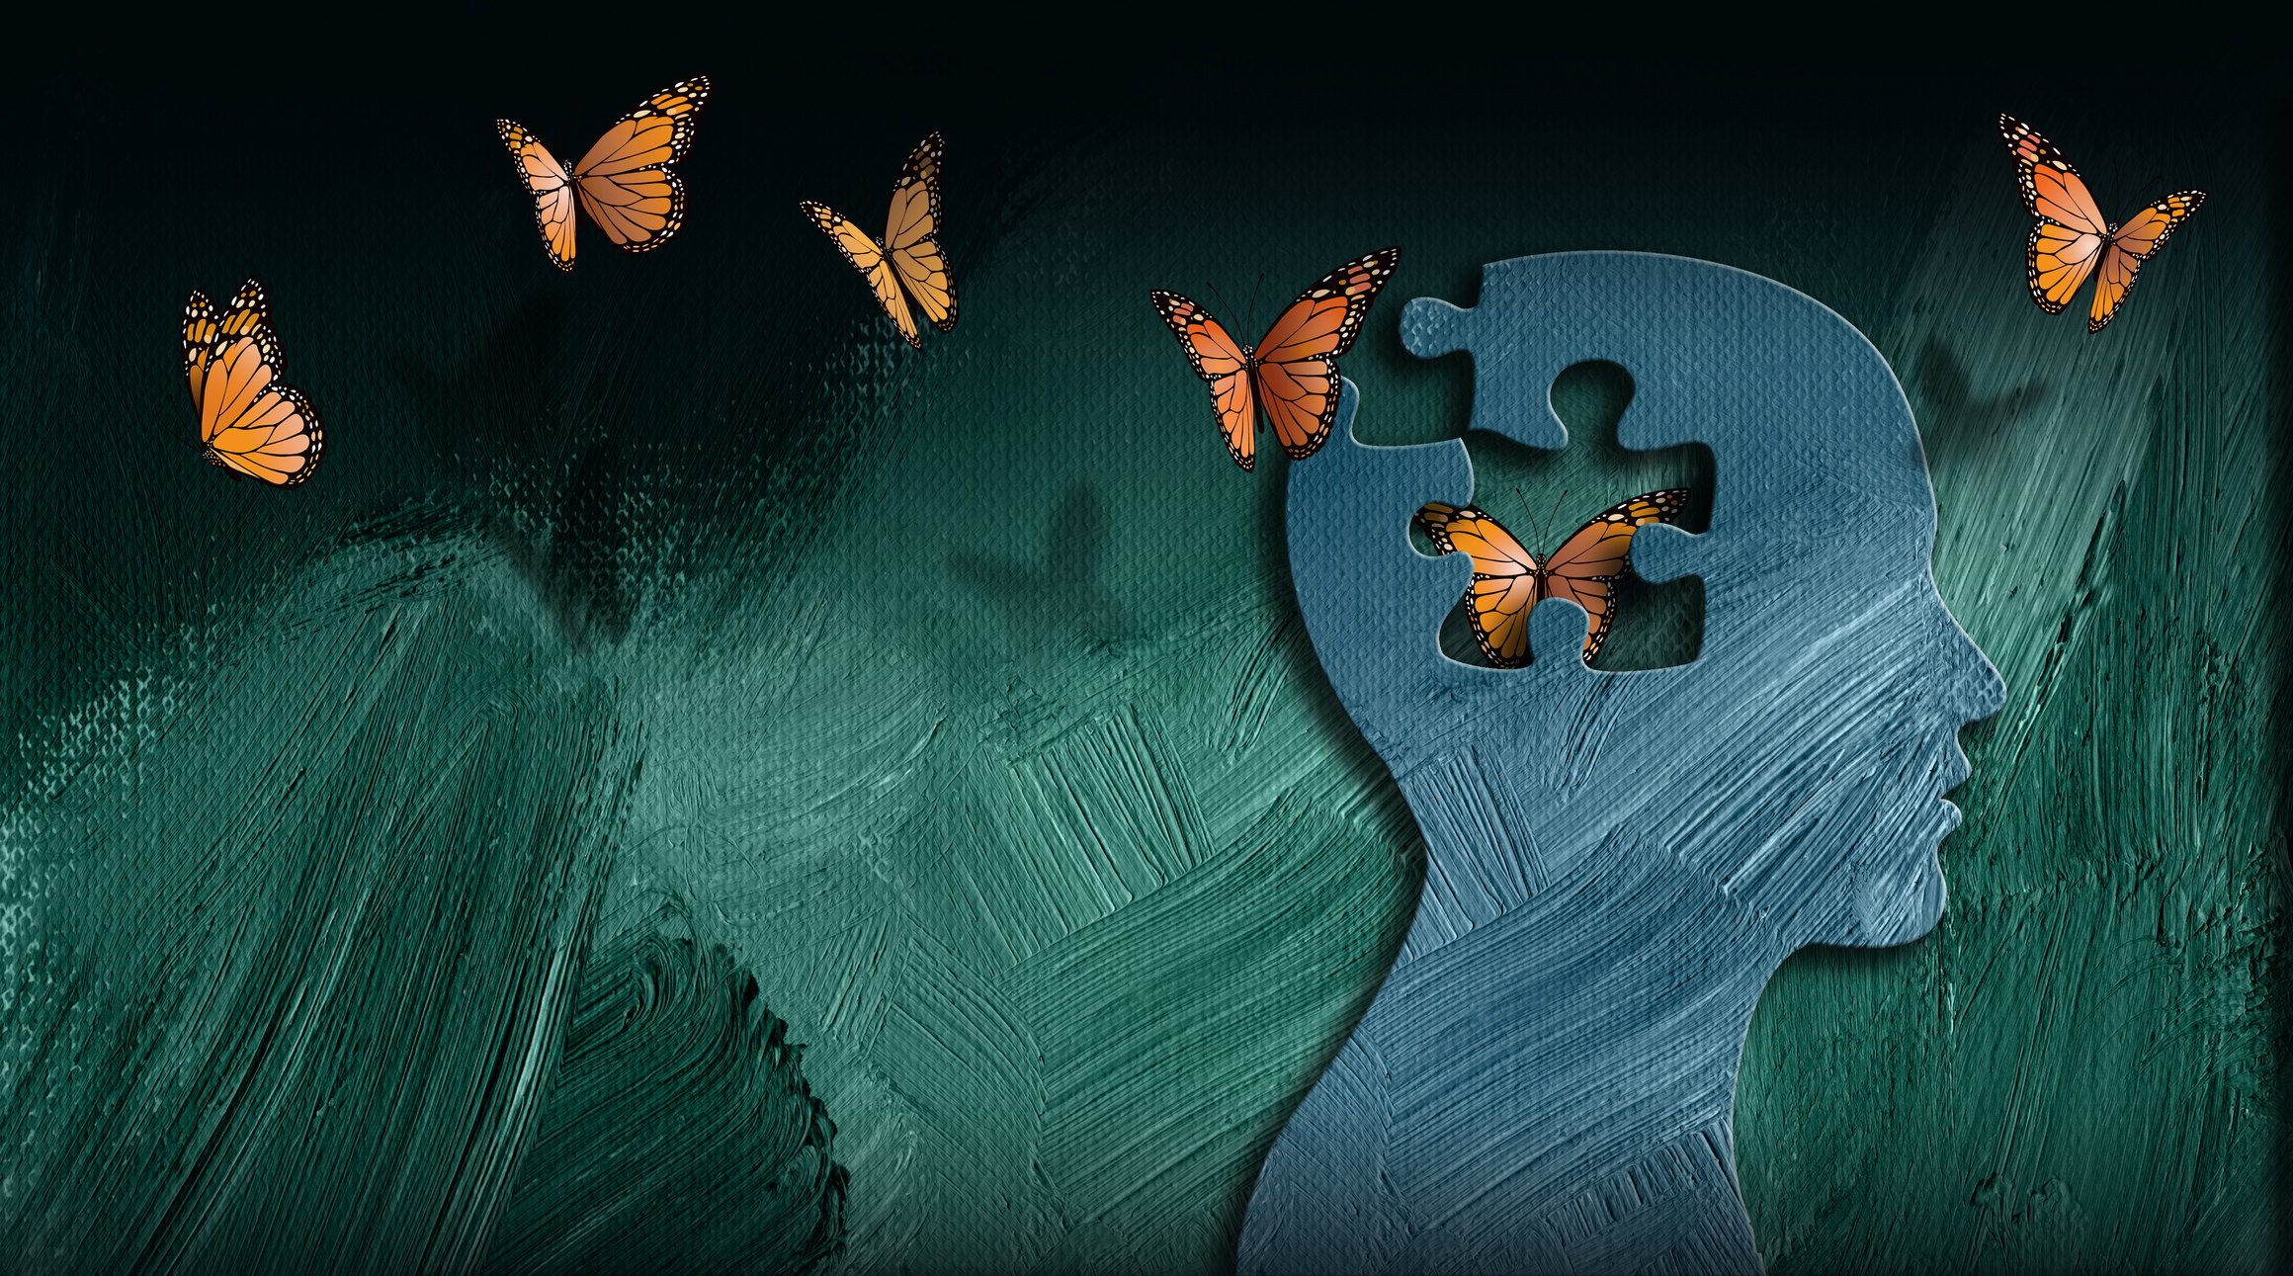
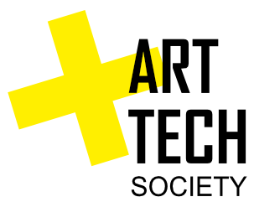
Do we need a paradigm shift to create a brighter future?
Notes:
The content:
- We live in a very prosperous life with all positive aspects (higher life expectancy, almost all have access to education and health, etc)
- Though, we encounter the most difficult and complex problems as never before (climate change, but also pandemics, depression and loneliness)
- The current societal paradigm(s) or mental-models we have are impeding us to solve our problems in the right way and further develop a higher level of societal consciousness.
- Examples of paradigms are like silo thinking (we learn to do not relate music with biology), our rational and narrow-minded view of the world; our "superior" relationship with the natural environment and our power-centered prosperity (to name some)
- How to shift to a new paradigms? by developing soft abilities like critical thinking, self-reflection, be open- (heart & minded) to learn from others perspectives, become more creative, envision something different and create new technology to make this new future happen.
- What ATS is proposing? three programs where cultural expeditions focus on reflection and learn from other perspectives
- What if.... visions of the new future (e.g. human development vs academic education; new economy focus on the well-being of communities; practicing more art to develop soft abilities, etc)
- Invitation to join our next events and
- Closing by inviting people to join Equal Table - open discussion

Slide 2
Welcome

Slide 3
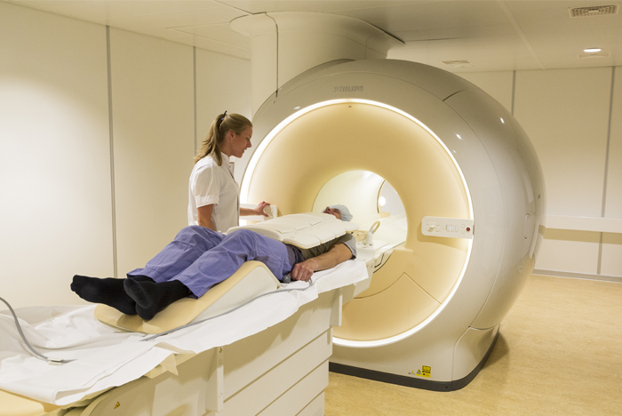
Our present
Notes:
The content:
- We live in a very prosperous life with all positive aspects (higher life expectancy, almost all have access to education and health, etc)
- Though, we encounter the most difficult and complex problems as never before (climate change, but also pandemics, depression and loneliness)
- The current societal paradigm(s) or mental-models we have are impeding us to solve our problems in the right way and further develop a higher level of societal consciousness.
- Examples of paradigms are like silo thinking (we learn to do not relate music with biology), our rational and narrow-minded view of the world; our "superior" relationship with the natural environment and our power-centered prosperity (to name some)
- How to shift to a new paradigms? by developing soft abilities like critical thinking, self-reflection, be open- (heart & minded) to learn from others perspectives, become more creative, envision something different and create new technology to make this new future happen.
- What ATS is proposing? three programs where cultural expeditions focus on reflection and learn from other perspectives
- What if.... visions of the new future (e.g. human development vs academic education; new economy focus on the well-being of communities; practicing more art to develop soft abilities, etc)
- Invitation to join our next events and
- Closing by inviting people to join Equal Table - open discussion

Slide 4
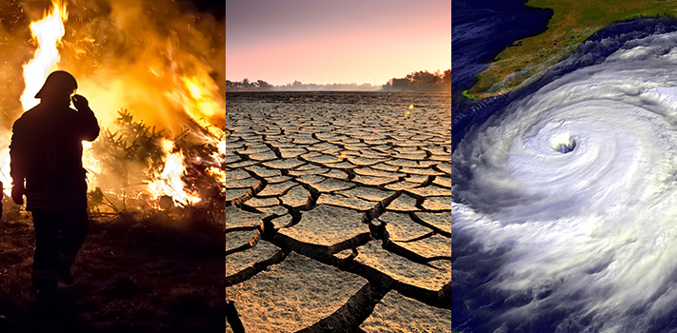
Our present
Notes:
The content:
- We live in a very prosperous life with all positive aspects (higher life expectancy, almost all have access to education and health, etc)
- Though, we encounter the most difficult and complex problems as never before (climate change, but also pandemics, depression and loneliness)
- The current societal paradigm(s) or mental-models we have are impeding us to solve our problems in the right way and further develop a higher level of societal consciousness.
- Examples of paradigms are like silo thinking (we learn to do not relate music with biology), our rational and narrow-minded view of the world; our "superior" relationship with the natural environment and our power-centered prosperity (to name some)
- How to shift to a new paradigms? by developing soft abilities like critical thinking, self-reflection, be open- (heart & minded) to learn from others perspectives, become more creative, envision something different and create new technology to make this new future happen.
- What ATS is proposing? three programs where cultural expeditions focus on reflection and learn from other perspectives
- What if.... visions of the new future (e.g. human development vs academic education; new economy focus on the well-being of communities; practicing more art to develop soft abilities, etc)
- Invitation to join our next events and
- Closing by inviting people to join Equal Table - open discussion

Slide 5
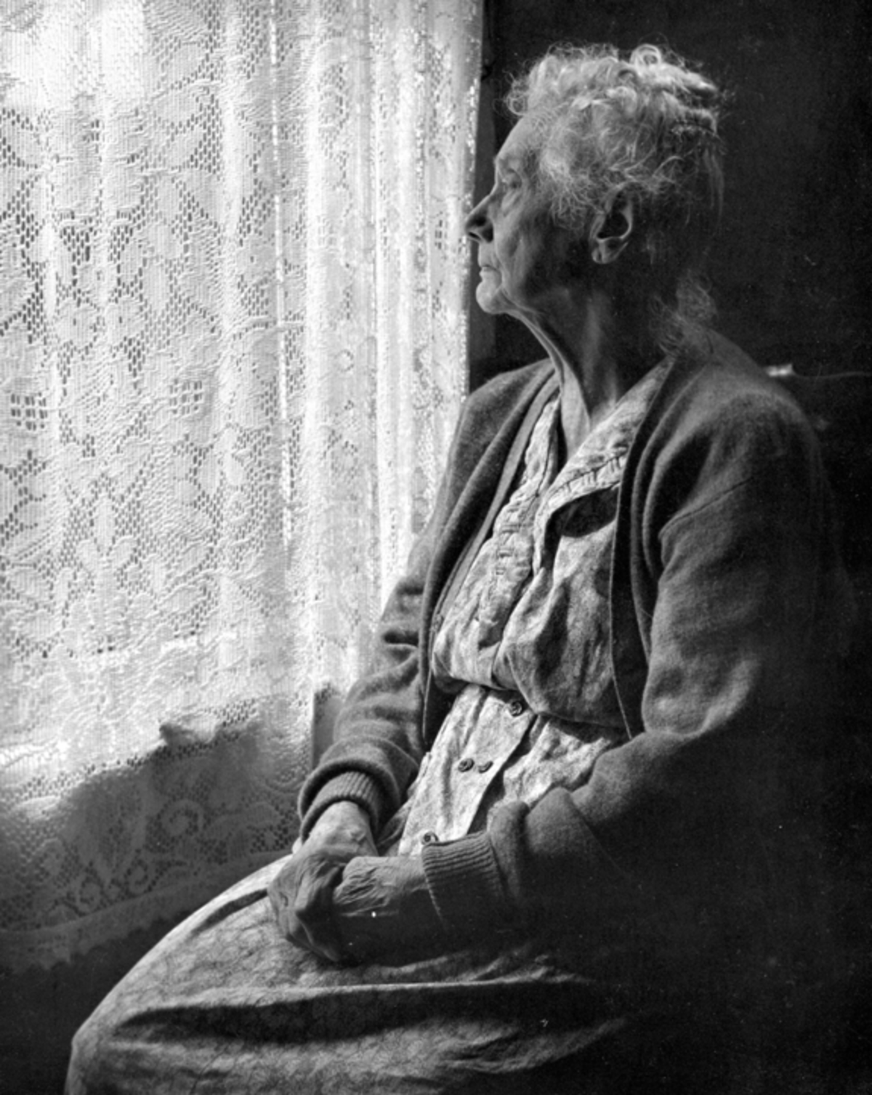
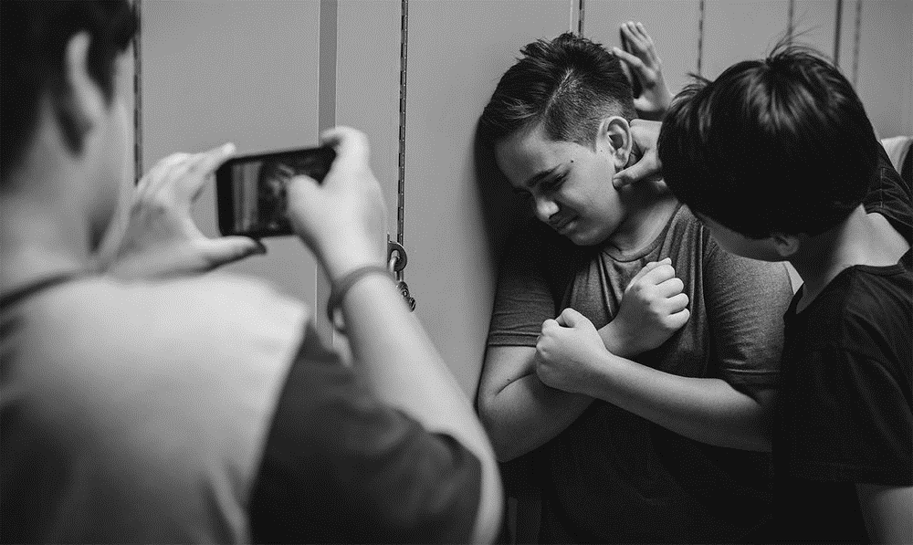
Our present
Notes:
The content:
- We live in a very prosperous life with all positive aspects (higher life expectancy, almost all have access to education and health, etc)
- Though, we encounter the most difficult and complex problems as never before (climate change, but also pandemics, depression and loneliness)
- The current societal paradigm(s) or mental-models we have are impeding us to solve our problems in the right way and further develop a higher level of societal consciousness.
- Examples of paradigms are like silo thinking (we learn to do not relate music with biology), our rational and narrow-minded view of the world; our "superior" relationship with the natural environment and our power-centered prosperity (to name some)
- How to shift to a new paradigms? by developing soft abilities like critical thinking, self-reflection, be open- (heart & minded) to learn from others perspectives, become more creative, envision something different and create new technology to make this new future happen.
- What ATS is proposing? three programs where cultural expeditions focus on reflection and learn from other perspectives
- What if.... visions of the new future (e.g. human development vs academic education; new economy focus on the well-being of communities; practicing more art to develop soft abilities, etc)
- Invitation to join our next events and
- Closing by inviting people to join Equal Table - open discussion

Slide 6
Our societal paradigms have become our obstacles
Notes:
The content:
- We live in a very prosperous life with all positive aspects (higher life expectancy, almost all have access to education and health, etc)
- Though, we encounter the most difficult and complex problems as never before (climate change, but also pandemics, depression and loneliness)
- The current societal paradigm(s) or mental-models we have are impeding us to solve our problems in the right way and further develop a higher level of societal consciousness.
- Examples of paradigms are like silo thinking (we learn to do not relate music with biology), our rational and narrow-minded view of the world; our "superior" relationship with the natural environment and our power-centered prosperity (to name some)
- How to shift to a new paradigms? by developing soft abilities like critical thinking, self-reflection, be open- (heart & minded) to learn from others perspectives, become more creative, envision something different and create new technology to make this new future happen.
- What ATS is proposing? three programs where cultural expeditions focus on reflection and learn from other perspectives
- What if.... visions of the new future (e.g. human development vs academic education; new economy focus on the well-being of communities; practicing more art to develop soft abilities, etc)
- Invitation to join our next events and
- Closing by inviting people to join Equal Table - open discussion

Slide 7
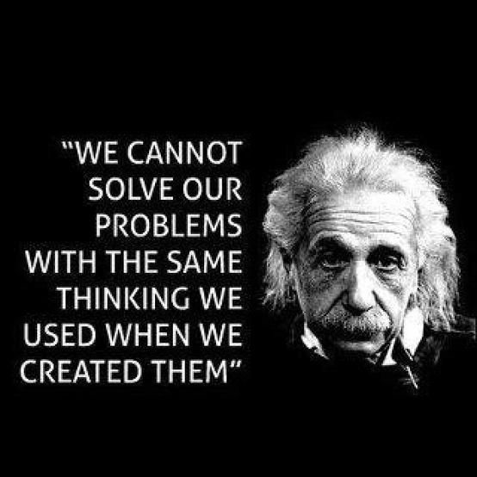
Notes:
The content:
- We live in a very prosperous life with all positive aspects (higher life expectancy, almost all have access to education and health, etc)
- Though, we encounter the most difficult and complex problems as never before (climate change, but also pandemics, depression and loneliness)
- The current societal paradigm(s) or mental-models we have are impeding us to solve our problems in the right way and further develop a higher level of societal consciousness.
- Examples of paradigms are like silo thinking (we learn to do not relate music with biology), our rational and narrow-minded view of the world; our "superior" relationship with the natural environment and our power-centered prosperity (to name some)
- How to shift to a new paradigms? by developing soft abilities like critical thinking, self-reflection, be open- (heart & minded) to learn from others perspectives, become more creative, envision something different and create new technology to make this new future happen.
- What ATS is proposing? three programs where cultural expeditions focus on reflection and learn from other perspectives
- What if.... visions of the new future (e.g. human development vs academic education; new economy focus on the well-being of communities; practicing more art to develop soft abilities, etc)
- Invitation to join our next events and
- Closing by inviting people to join Equal Table - open discussion

Slide 8
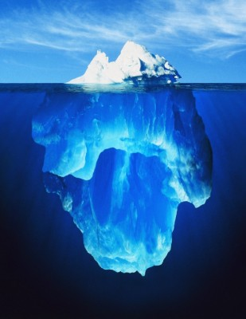
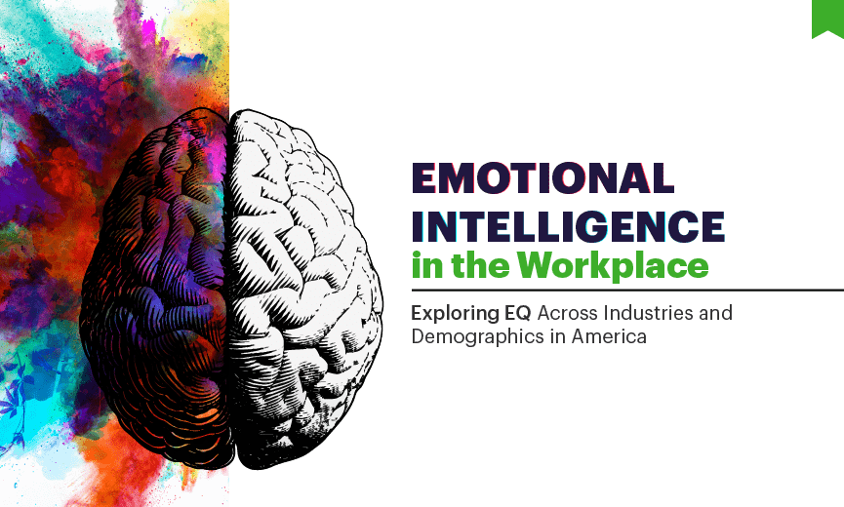
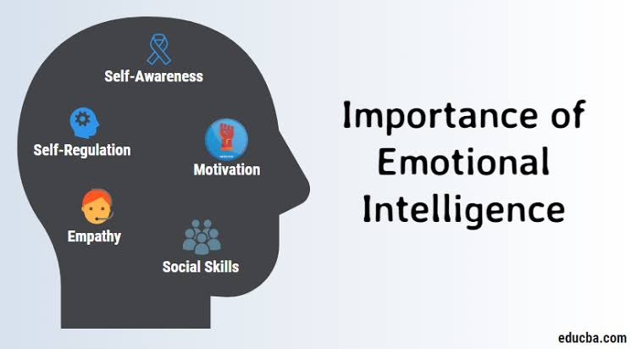
Our narrowed and rational minded
Notes:
The content:
- We live in a very prosperous life with all positive aspects (higher life expectancy, almost all have access to education and health, etc)
- Though, we encounter the most difficult and complex problems as never before (climate change, but also pandemics, depression and loneliness)
- The current societal paradigm(s) or mental-models we have are impeding us to solve our problems in the right way and further develop a higher level of societal consciousness.
- Examples of paradigms are like silo thinking (we learn to do not relate music with biology), our rational and narrow-minded view of the world; our "superior" relationship with the natural environment and our power-centered prosperity (to name some)
- How to shift to a new paradigms? by developing soft abilities like critical thinking, self-reflection, be open- (heart & minded) to learn from others perspectives, become more creative, envision something different and create new technology to make this new future happen.
- What ATS is proposing? three programs where cultural expeditions focus on reflection and learn from other perspectives
- What if.... visions of the new future (e.g. human development vs academic education; new economy focus on the well-being of communities; practicing more art to develop soft abilities, etc)
- Invitation to join our next events and
- Closing by inviting people to join Equal Table - open discussion

Slide 9
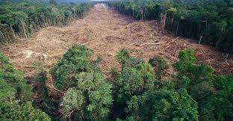
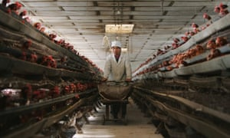
Our relationship with Nature
Notes:
The content:
- We live in a very prosperous life with all positive aspects (higher life expectancy, almost all have access to education and health, etc)
- Though, we encounter the most difficult and complex problems as never before (climate change, but also pandemics, depression and loneliness)
- The current societal paradigm(s) or mental-models we have are impeding us to solve our problems in the right way and further develop a higher level of societal consciousness.
- Examples of paradigms are like silo thinking (we learn to do not relate music with biology), our rational and narrow-minded view of the world; our "superior" relationship with the natural environment and our power-centered prosperity (to name some)
- How to shift to a new paradigms? by developing soft abilities like critical thinking, self-reflection, be open- (heart & minded) to learn from others perspectives, become more creative, envision something different and create new technology to make this new future happen.
- What ATS is proposing? three programs where cultural expeditions focus on reflection and learn from other perspectives
- What if.... visions of the new future (e.g. human development vs academic education; new economy focus on the well-being of communities; practicing more art to develop soft abilities, etc)
- Invitation to join our next events and
- Closing by inviting people to join Equal Table - open discussion

Slide 10
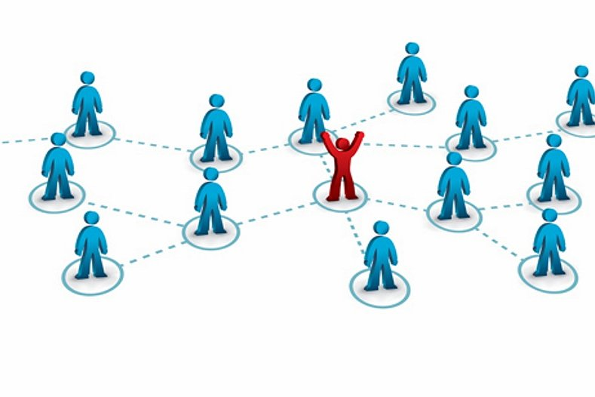
Our power centric attitude
Notes:
The content:
- We live in a very prosperous life with all positive aspects (higher life expectancy, almost all have access to education and health, etc)
- Though, we encounter the most difficult and complex problems as never before (climate change, but also pandemics, depression and loneliness)
- The current societal paradigm(s) or mental-models we have are impeding us to solve our problems in the right way and further develop a higher level of societal consciousness.
- Examples of paradigms are like silo thinking (we learn to do not relate music with biology), our rational and narrow-minded view of the world; our "superior" relationship with the natural environment and our power-centered prosperity (to name some)
- How to shift to a new paradigms? by developing soft abilities like critical thinking, self-reflection, be open- (heart & minded) to learn from others perspectives, become more creative, envision something different and create new technology to make this new future happen.
- What ATS is proposing? three programs where cultural expeditions focus on reflection and learn from other perspectives
- What if.... visions of the new future (e.g. human development vs academic education; new economy focus on the well-being of communities; practicing more art to develop soft abilities, etc)
- Invitation to join our next events and
- Closing by inviting people to join Equal Table - open discussion

Slide 11
How to switch to new paradigms?
Notes:
The content:
- We live in a very prosperous life with all positive aspects (higher life expectancy, almost all have access to education and health, etc)
- Though, we encounter the most difficult and complex problems as never before (climate change, but also pandemics, depression and loneliness)
- The current societal paradigm(s) or mental-models we have are impeding us to solve our problems in the right way and further develop a higher level of societal consciousness.
- Examples of paradigms are like silo thinking (we learn to do not relate music with biology), our rational and narrow-minded view of the world; our "superior" relationship with the natural environment and our power-centered prosperity (to name some)
- How to shift to a new paradigms? by developing soft abilities like critical thinking, self-reflection, be open- (heart & minded) to learn from others perspectives, become more creative, envision something different and create new technology to make this new future happen.
- What ATS is proposing? three programs where cultural expeditions focus on reflection and learn from other perspectives
- What if.... visions of the new future (e.g. human development vs academic education; new economy focus on the well-being of communities; practicing more art to develop soft abilities, etc)
- Invitation to join our next events and
- Closing by inviting people to join Equal Table - open discussion

Slide 12
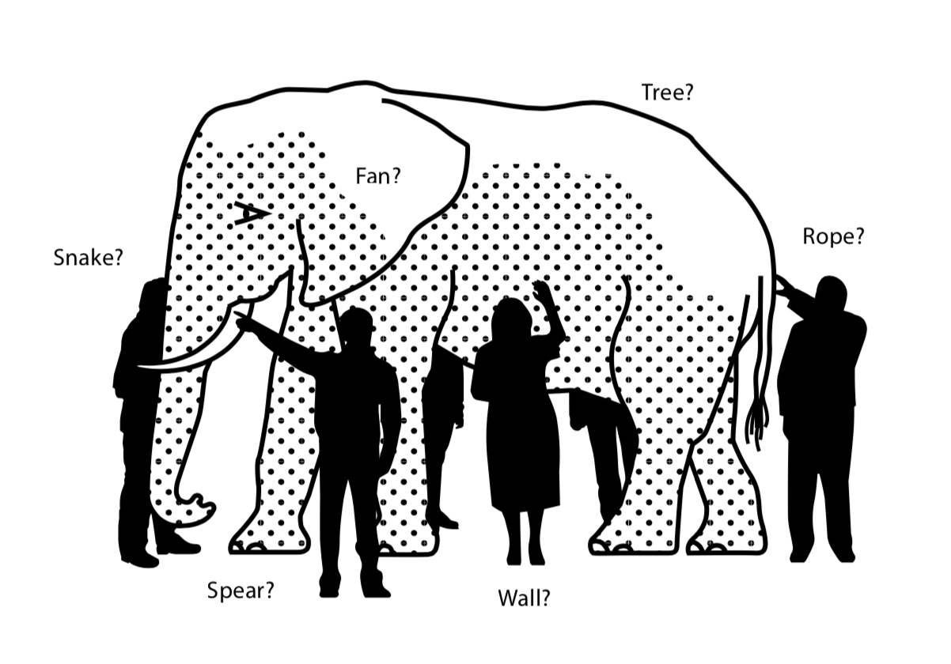
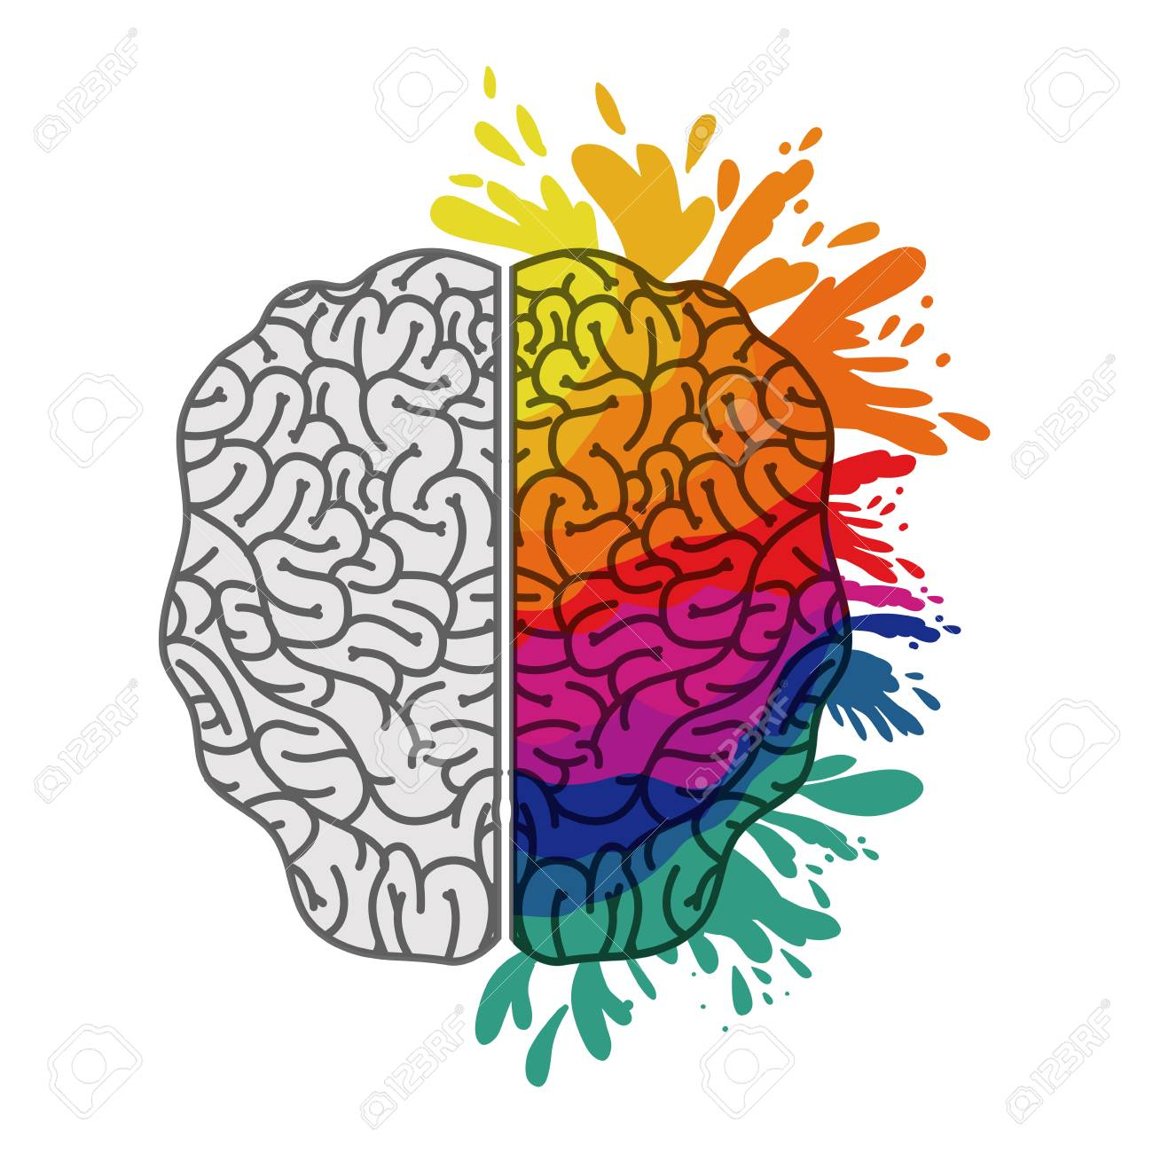
Development of soft abilities
Critically thinking
Reflection
Dreaming and envisioning
Learn from other perspectives
Become creative
Notes:
The content:
- We live in a very prosperous life with all positive aspects (higher life expectancy, almost all have access to education and health, etc)
- Though, we encounter the most difficult and complex problems as never before (climate change, but also pandemics, depression and loneliness)
- The current societal paradigm(s) or mental-models we have are impeding us to solve our problems in the right way and further develop a higher level of societal consciousness.
- Examples of paradigms are like silo thinking (we learn to do not relate music with biology), our rational and narrow-minded view of the world; our "superior" relationship with the natural environment and our power-centered prosperity (to name some)
- How to shift to a new paradigms? by developing soft abilities like critical thinking, self-reflection, be open- (heart & minded) to learn from others perspectives, become more creative, envision something different and create new technology to make this new future happen.
- What ATS is proposing? three programs where cultural expeditions focus on reflection and learn from other perspectives
- What if.... visions of the new future (e.g. human development vs academic education; new economy focus on the well-being of communities; practicing more art to develop soft abilities, etc)
- Invitation to join our next events and
- Closing by inviting people to join Equal Table - open discussion

Slide 13
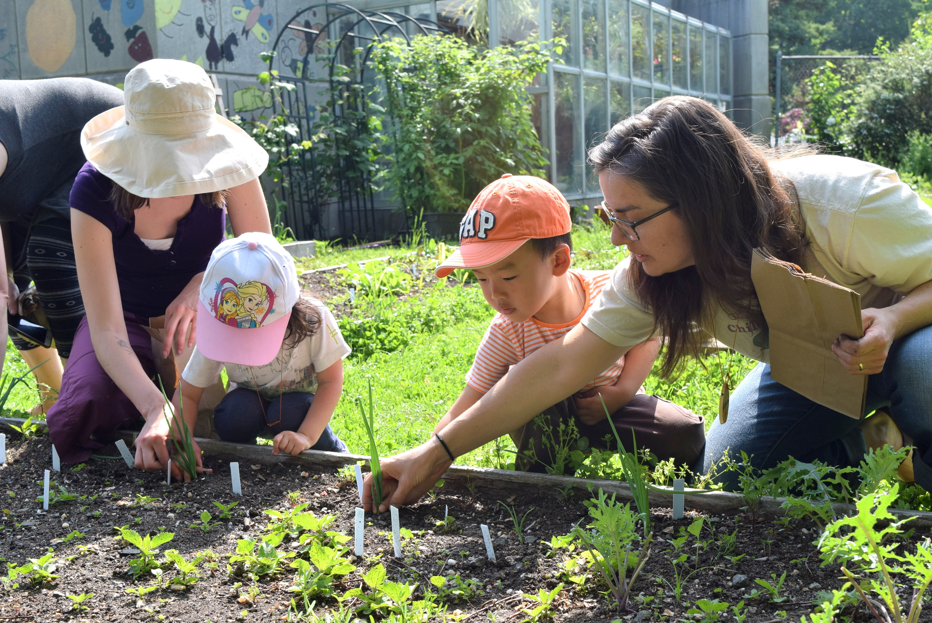
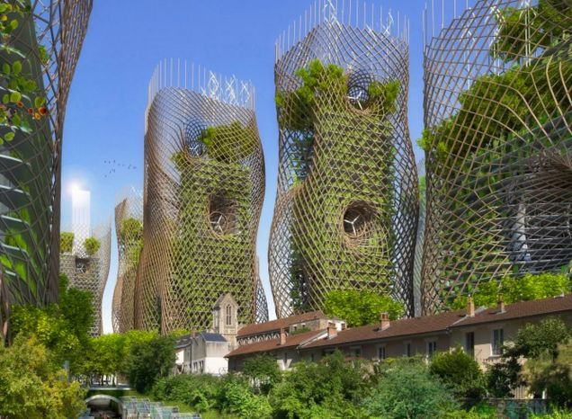
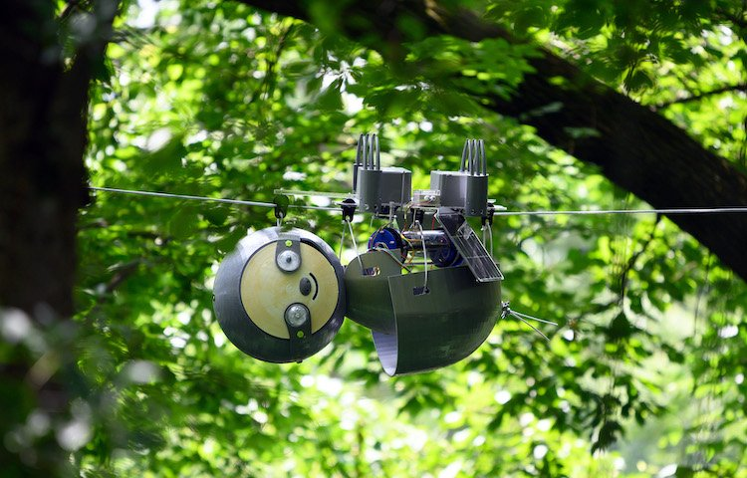
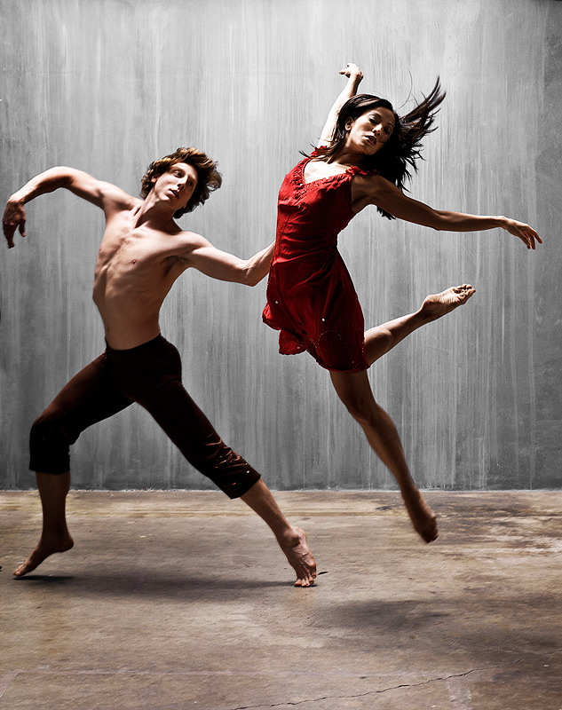
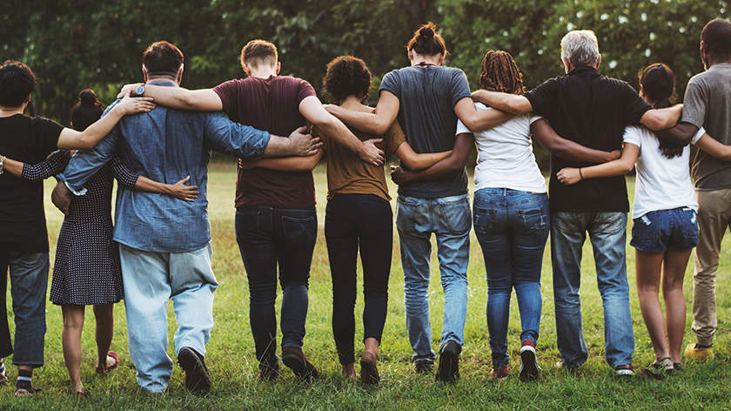
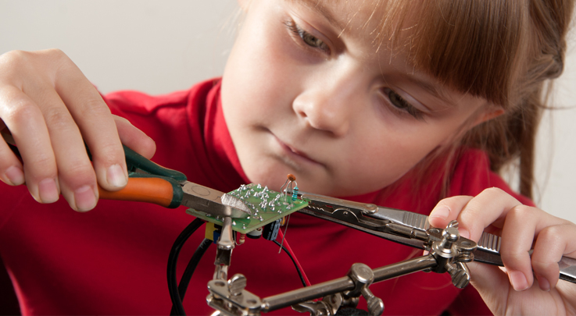
What if…
Notes:
The content:
- We live in a very prosperous life with all positive aspects (higher life expectancy, almost all have access to education and health, etc)
- Though, we encounter the most difficult and complex problems as never before (climate change, but also pandemics, depression and loneliness)
- The current societal paradigm(s) or mental-models we have are impeding us to solve our problems in the right way and further develop a higher level of societal consciousness.
- Examples of paradigms are like silo thinking (we learn to do not relate music with biology), our rational and narrow-minded view of the world; our "superior" relationship with the natural environment and our power-centered prosperity (to name some)
- How to shift to a new paradigms? by developing soft abilities like critical thinking, self-reflection, be open- (heart & minded) to learn from others perspectives, become more creative, envision something different and create new technology to make this new future happen.
- What ATS is proposing? three programs where cultural expeditions focus on reflection and learn from other perspectives
- What if.... visions of the new future (e.g. human development vs academic education; new economy focus on the well-being of communities; practicing more art to develop soft abilities, etc)
- Invitation to join our next events and
- Closing by inviting people to join Equal Table - open discussion

Slide 14
What is Art + Tech Society doing about it?
Notes:
The content:
- We live in a very prosperous life with all positive aspects (higher life expectancy, almost all have access to education and health, etc)
- Though, we encounter the most difficult and complex problems as never before (climate change, but also pandemics, depression and loneliness)
- The current societal paradigm(s) or mental-models we have are impeding us to solve our problems in the right way and further develop a higher level of societal consciousness.
- Examples of paradigms are like silo thinking (we learn to do not relate music with biology), our rational and narrow-minded view of the world; our "superior" relationship with the natural environment and our power-centered prosperity (to name some)
- How to shift to a new paradigms? by developing soft abilities like critical thinking, self-reflection, be open- (heart & minded) to learn from others perspectives, become more creative, envision something different and create new technology to make this new future happen.
- What ATS is proposing? three programs where cultural expeditions focus on reflection and learn from other perspectives
- What if.... visions of the new future (e.g. human development vs academic education; new economy focus on the well-being of communities; practicing more art to develop soft abilities, etc)
- Invitation to join our next events and
- Closing by inviting people to join Equal Table - open discussion

Slide 15
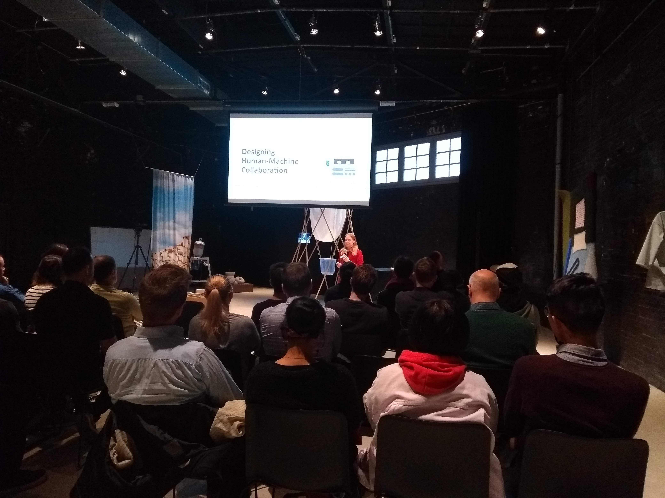
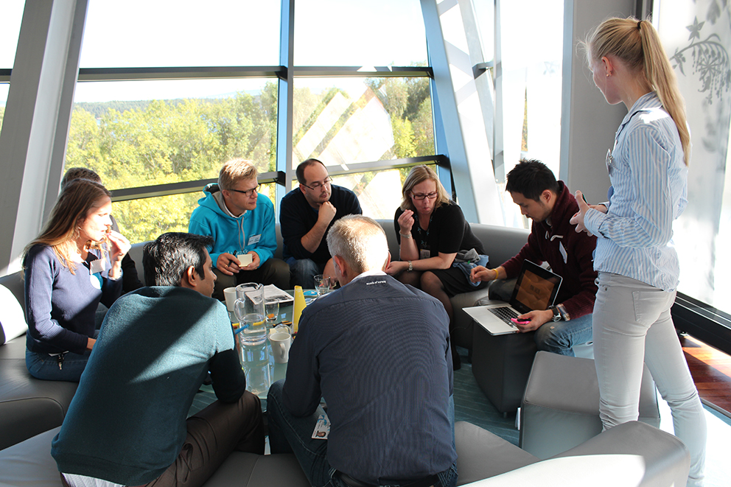
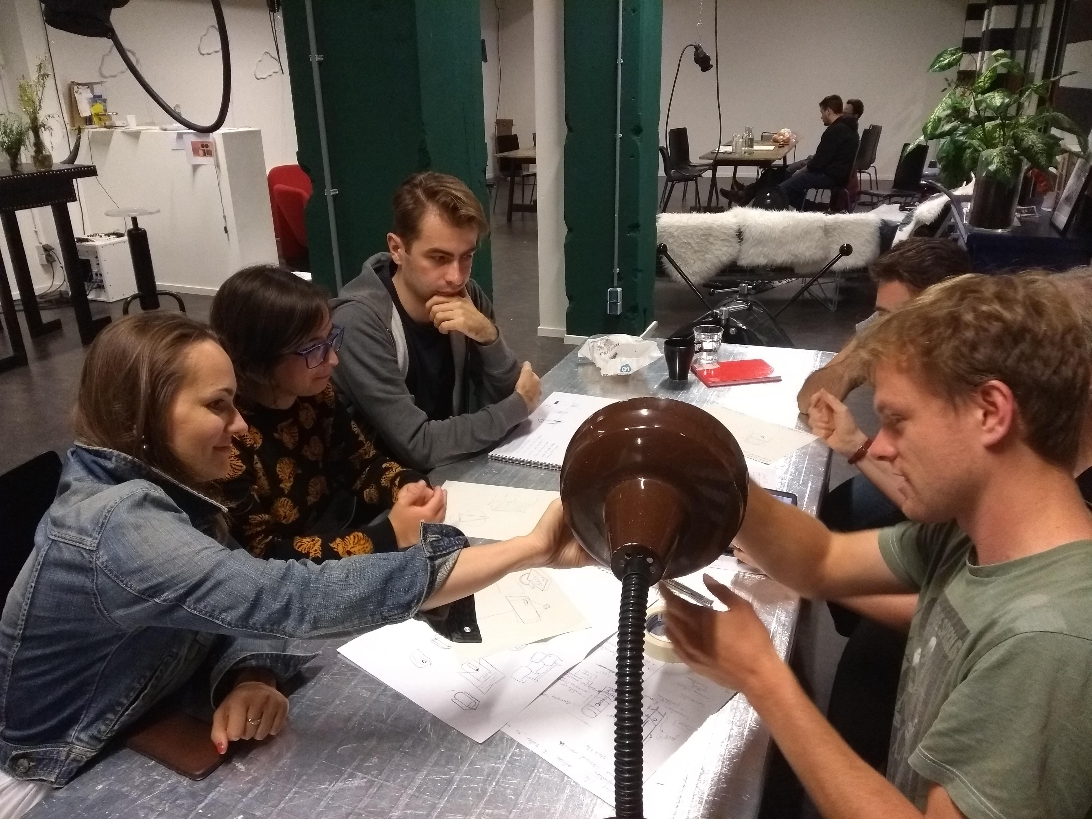
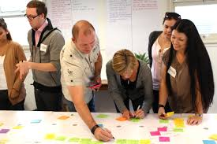
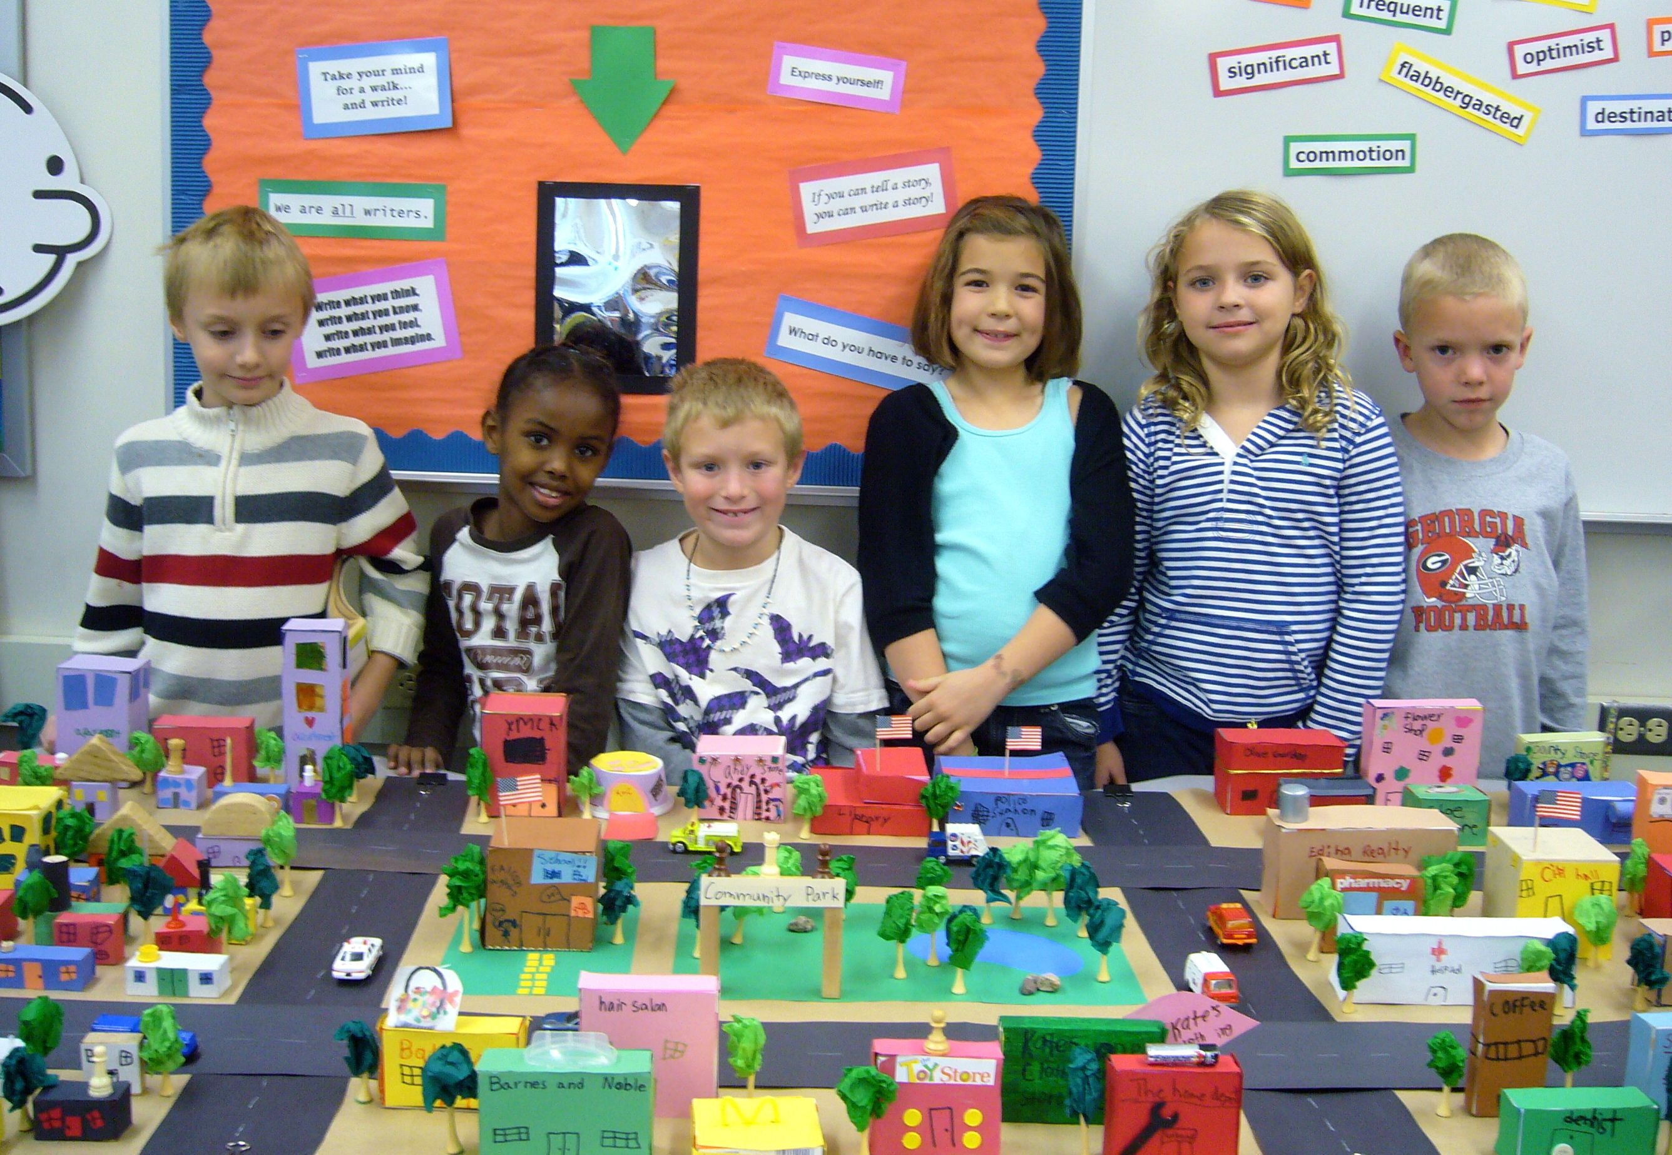
Three complementary programs
Cultural Expeditions
City Think Tank
Future Making Lab
Connecting Eindhoven
City Game
Notes:
The content:
- We live in a very prosperous life with all positive aspects (higher life expectancy, almost all have access to education and health, etc)
- Though, we encounter the most difficult and complex problems as never before (climate change, but also pandemics, depression and loneliness)
- The current societal paradigm(s) or mental-models we have are impeding us to solve our problems in the right way and further develop a higher level of societal consciousness.
- Examples of paradigms are like silo thinking (we learn to do not relate music with biology), our rational and narrow-minded view of the world; our "superior" relationship with the natural environment and our power-centered prosperity (to name some)
- How to shift to a new paradigms? by developing soft abilities like critical thinking, self-reflection, be open- (heart & minded) to learn from others perspectives, become more creative, envision something different and create new technology to make this new future happen.
- What ATS is proposing? three programs where cultural expeditions focus on reflection and learn from other perspectives
- What if.... visions of the new future (e.g. human development vs academic education; new economy focus on the well-being of communities; practicing more art to develop soft abilities, etc)
- Invitation to join our next events and
- Closing by inviting people to join Equal Table - open discussion

Slide 16
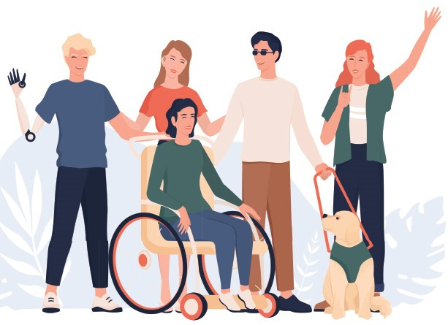
Cultural Expeditions 2021
Jan-Mar
“A world full of bubbles”
Apr-Jun
Our relationship with Nature
Sep-Nov
Human Prosperity
Notes:
The content:
- We live in a very prosperous life with all positive aspects (higher life expectancy, almost all have access to education and health, etc)
- Though, we encounter the most difficult and complex problems as never before (climate change, but also pandemics, depression and loneliness)
- The current societal paradigm(s) or mental-models we have are impeding us to solve our problems in the right way and further develop a higher level of societal consciousness.
- Examples of paradigms are like silo thinking (we learn to do not relate music with biology), our rational and narrow-minded view of the world; our "superior" relationship with the natural environment and our power-centered prosperity (to name some)
- How to shift to a new paradigms? by developing soft abilities like critical thinking, self-reflection, be open- (heart & minded) to learn from others perspectives, become more creative, envision something different and create new technology to make this new future happen.
- What ATS is proposing? three programs where cultural expeditions focus on reflection and learn from other perspectives
- What if.... visions of the new future (e.g. human development vs academic education; new economy focus on the well-being of communities; practicing more art to develop soft abilities, etc)
- Invitation to join our next events and
- Closing by inviting people to join Equal Table - open discussion

Slide 17
Open discussion: Is our relationship with the natural environment ethical?
Notes:
The content:
- We live in a very prosperous life with all positive aspects (higher life expectancy, almost all have access to education and health, etc)
- Though, we encounter the most difficult and complex problems as never before (climate change, but also pandemics, depression and loneliness)
- The current societal paradigm(s) or mental-models we have are impeding us to solve our problems in the right way and further develop a higher level of societal consciousness.
- Examples of paradigms are like silo thinking (we learn to do not relate music with biology), our rational and narrow-minded view of the world; our "superior" relationship with the natural environment and our power-centered prosperity (to name some)
- How to shift to a new paradigms? by developing soft abilities like critical thinking, self-reflection, be open- (heart & minded) to learn from others perspectives, become more creative, envision something different and create new technology to make this new future happen.
- What ATS is proposing? three programs where cultural expeditions focus on reflection and learn from other perspectives
- What if.... visions of the new future (e.g. human development vs academic education; new economy focus on the well-being of communities; practicing more art to develop soft abilities, etc)
- Invitation to join our next events and
- Closing by inviting people to join Equal Table - open discussion

Slide 18
Notes:
The content:
- We live in a very prosperous life with all positive aspects (higher life expectancy, almost all have access to education and health, etc)
- Though, we encounter the most difficult and complex problems as never before (climate change, but also pandemics, depression and loneliness)
- The current societal paradigm(s) or mental-models we have are impeding us to solve our problems in the right way and further develop a higher level of societal consciousness.
- Examples of paradigms are like silo thinking (we learn to do not relate music with biology), our rational and narrow-minded view of the world; our "superior" relationship with the natural environment and our power-centered prosperity (to name some)
- How to shift to a new paradigms? by developing soft abilities like critical thinking, self-reflection, be open- (heart & minded) to learn from others perspectives, become more creative, envision something different and create new technology to make this new future happen.
- What ATS is proposing? three programs where cultural expeditions focus on reflection and learn from other perspectives
- What if.... visions of the new future (e.g. human development vs academic education; new economy focus on the well-being of communities; practicing more art to develop soft abilities, etc)
- Invitation to join our next events and
- Closing by inviting people to join Equal Table - open discussion

Slide 19
Thanks for being here !!

Slide 20
www.art-and-technology.org

